Slide 1
Running Apache Web Server as container (with persistent mounting)
Group 4
Norman Dzulkarnaen Bin Omar, Syahrul Afiq Bin Suran, Desmond Koh Ti Yong, Chong Nyuk Thong, Chan Yong Hoow, Chua Boon Kheng

Slide 2
Introduction
The age of virtualization has done a lot for allowing system admin and developers to build and experiment from their computers as if they were different systems.
We can run a Linux virtual machine from our Windows PC to test the functionality of a service like Apache Web Server running on a Linux OS.
It is far cheaper and easier to run a virtual machine than it is to buy a whole new computer.

Slide 3
Problems existing with Virtual Machines
Compatibility of each service with the libraries and dependencies of OS (One service requires version X of OS library. Another service – version Y of same library)
Every time version of any service updates, you might need to recheck compatibilities with underlying OS infrastructure
Virtual machines OS may take up large drive memory space and CPU computing resources.

Slide 4
Benefits / Problem Solved by Container Technology
Consistency Across Environments: Developers can "build once, run anywhere," ensuring the same application works the same way in different environments, from local development to production.
Speed: Containers are fast to start and stop, making them ideal for testing and deploying pipelines.
Efficient Use of Resources: Since containers share the host system's resources more effectively than virtual machines, they reduce overhead and allow for greater density in deployments.

Slide 5
Installation, Configuration and Test Scenarios
First, start our VM. Install Docker using the following curl command, which will download and run a shell script that will add the Docker repository to our system and install the package.
curl -fsSL https://get.docker.com | sh
Next, use the systemctl command to start the Docker service, enable it to start during reboots, and check its status.
systemctl start docker
systemctl enable docker
systemctl status docker

Slide 6
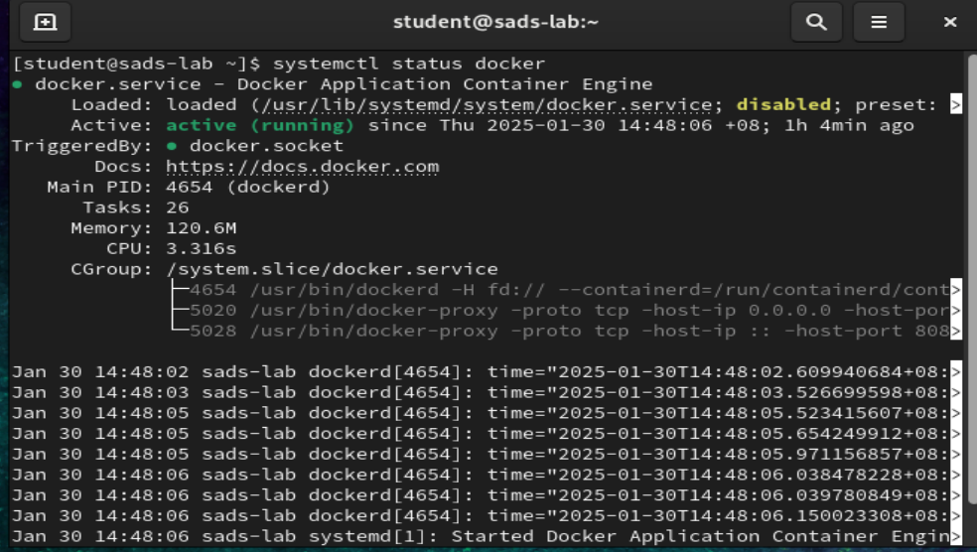
Installation, Configuration and Test Scenarios

Slide 7
Installation, Configuration and Test Scenarios
We will run an Apache 2.4 container and name it “student-web”, from the terminal. We will get an image called httpd:2.4 from Docker Hub.
Our plan is to have requests made to our IP address on port 8080 be redirected to port 80 on the container.
We map /home/student/website/ to the /usr/local/apache2/htdocs/ on the container. The command is as follows:
sudo docker run -dit --name student-web -p 8080:80 -v /home/student/website/:/usr/local/apache2/htdocs/ httpd:2.4

Slide 8
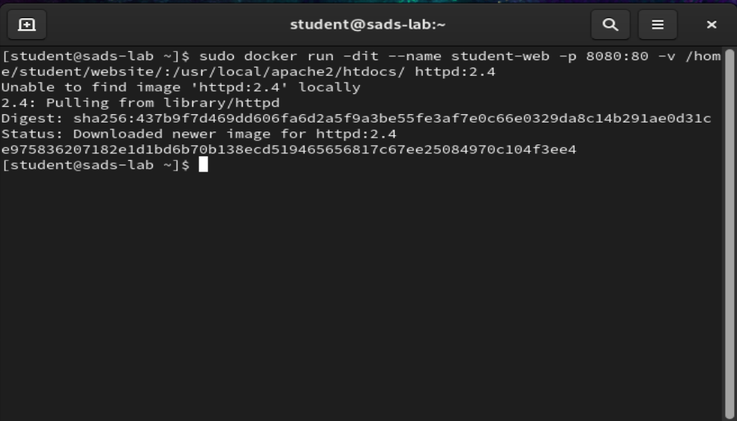
Installation, Configuration and Test Scenarios

Slide 9
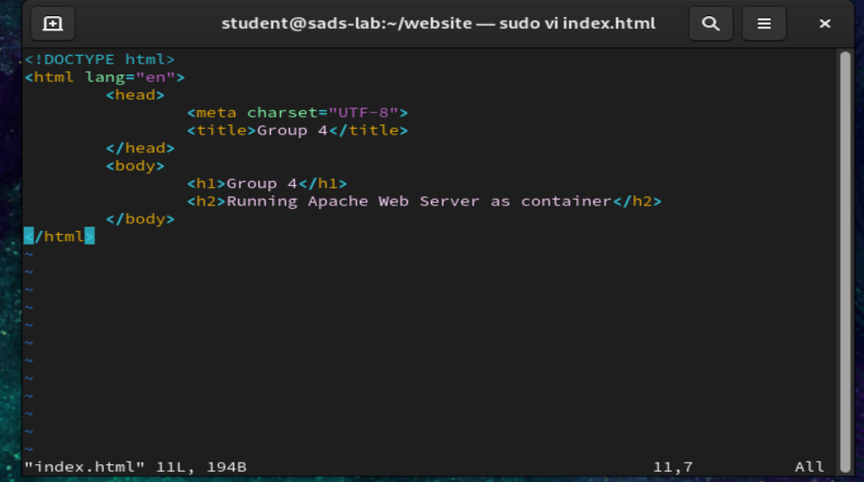
Installation, Configuration and Test Scenarios
Now we create a simple web page html file named index.html inside the /home/user/website directory using vi editor
sudo vi /home/student/website/index.html

Slide 10
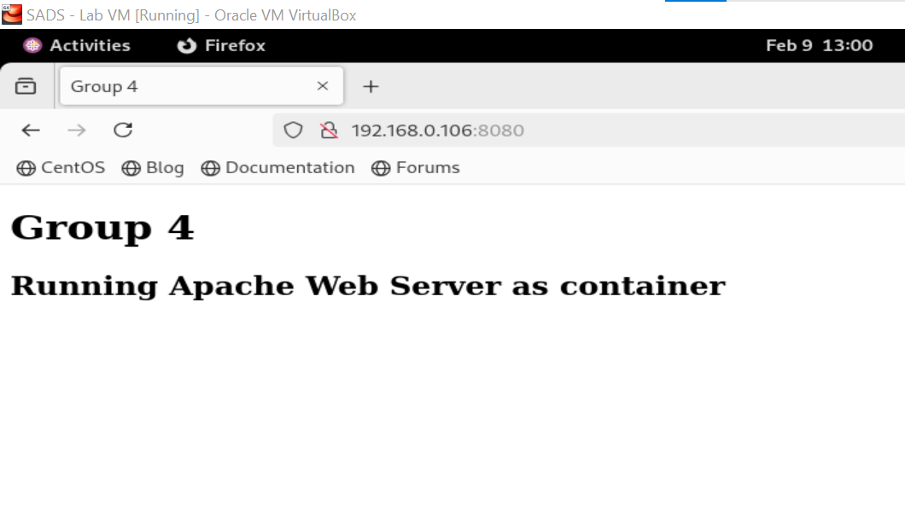
Installation, Configuration and Test Scenarios
Next, point our VM’s browser to 192.168.0.106:8080. You should be presented with the page we created previously.

Slide 11
Conclusion
After setting up a VM, the next question is to ask the most efficient method to add services and software so that the VM can be useful to the users.
Containers isolate the software and manage its fundamental dependencies, enabling it to run consistently across various environments.
This capability grants users the flexibility of portability and the ability to create multiple instances of the software as needed, all while efficiently utilizing resources.

Slide 12
Reference
How to set up Apache Web Server in a Docker Container.
Link: https://www.tecmint.com/install-apache-web-server-in-a-docker-container/

